Slide 1

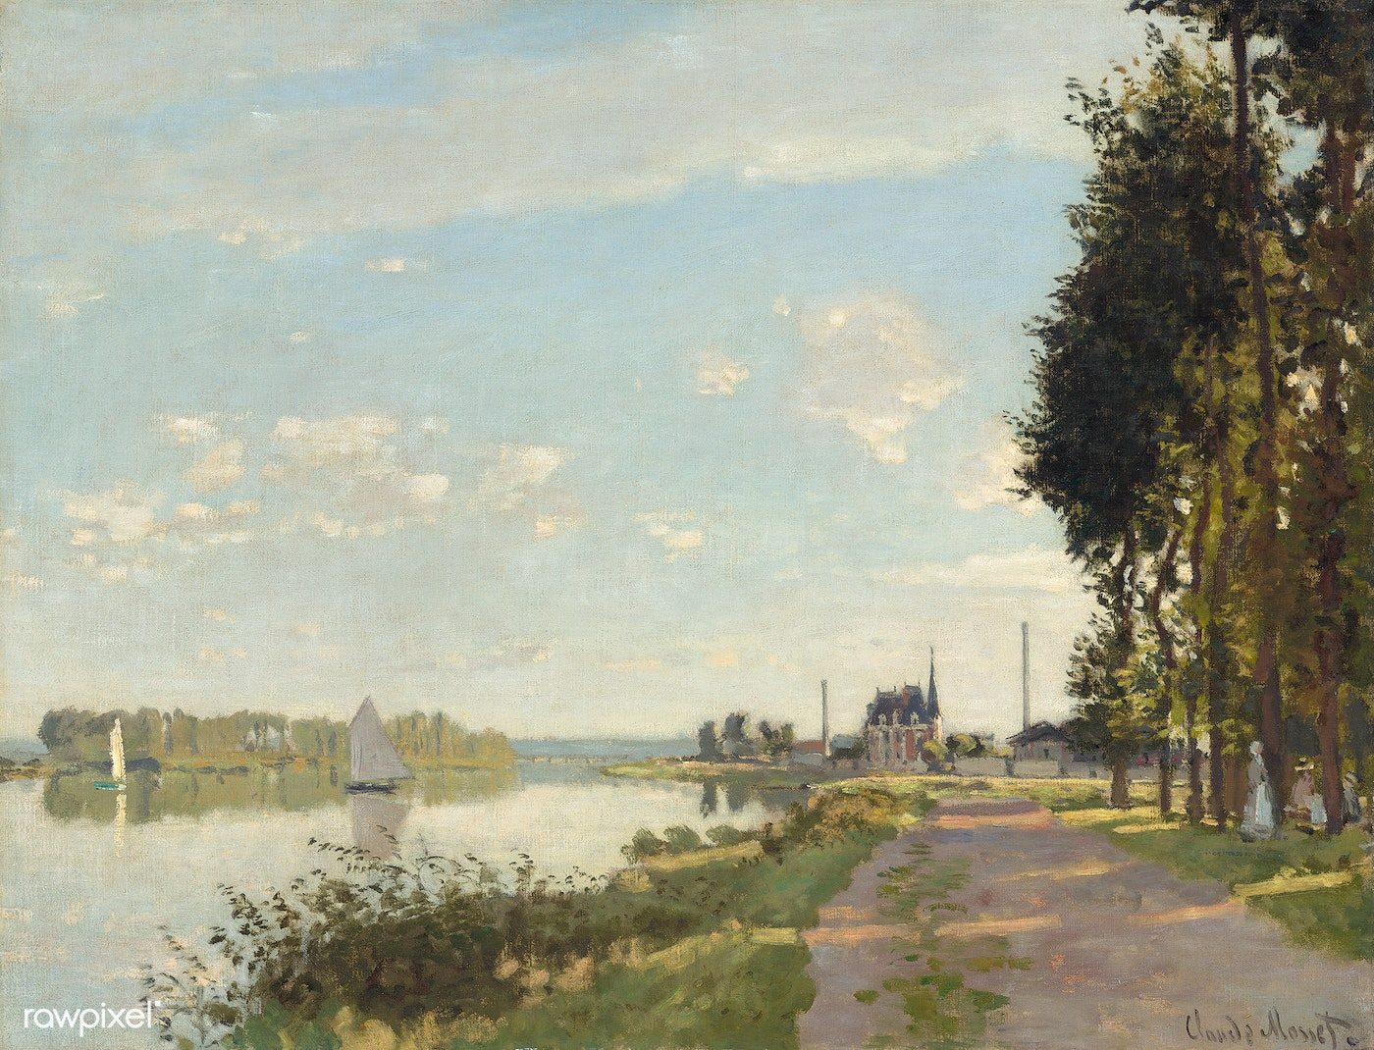
PANTONE® COLOR OF THE YEAR 2022
COLOR VARIATION ANALYSIS THROUGH PAINTINGS OF DIFFERENT PAINTERS
GUIDED BY : Dr. DOOTIKA VATS
BY :- GROUP 3
( ABHINAV KUMAR , KHYATI SINGH , SHUBHAM KUMAR, ROHIT DUTTA )

Slide 2
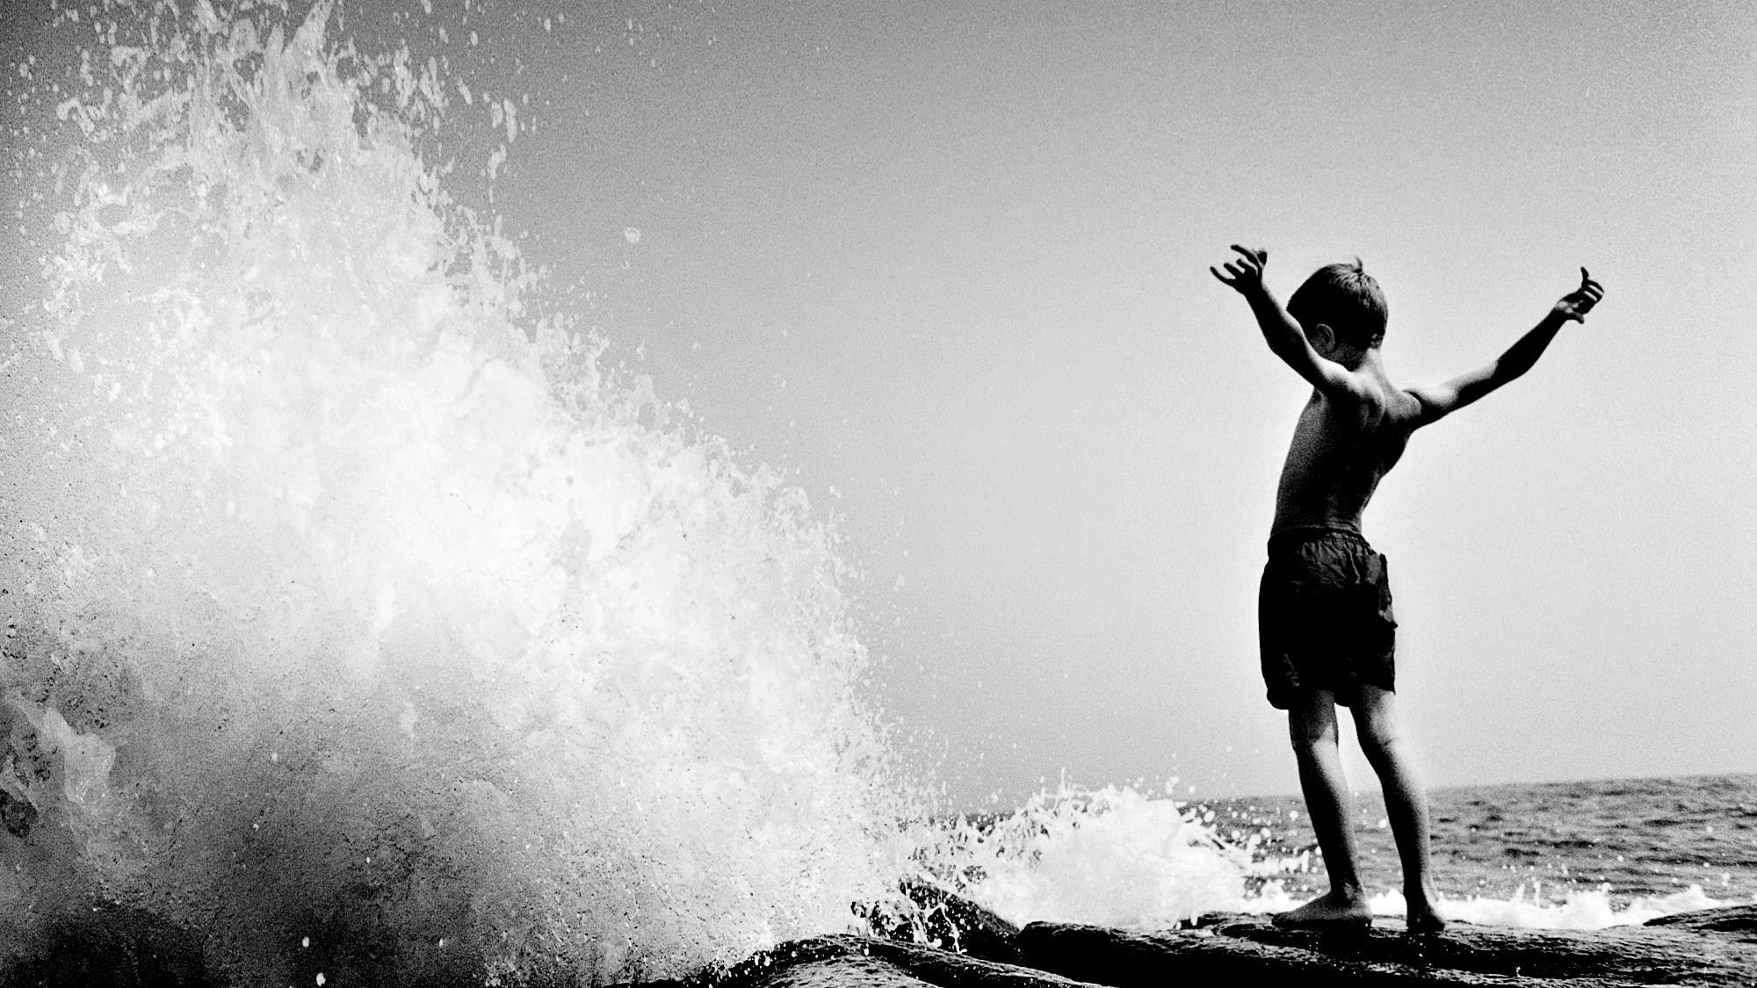
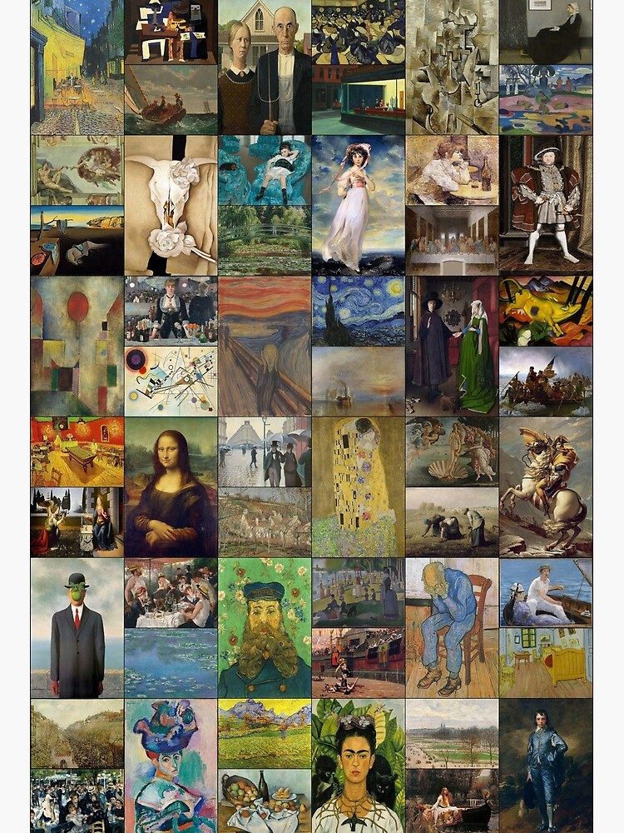
“Painting is the magical conjunction of space and no space; movement in stillness.” It is a form of expressing emotions, depicting things we observe.
Some of the famous painters of the world who made their contribution to art include Leonardo da Vinci, Raphael, Claude Monet, Salvador Dali, Vincent van Gogh, Pablo Picasso, Michelangelo, Rembrandt etc.

Slide 3
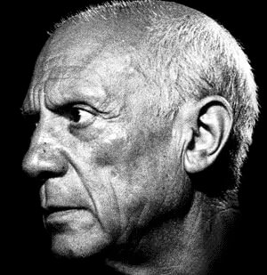
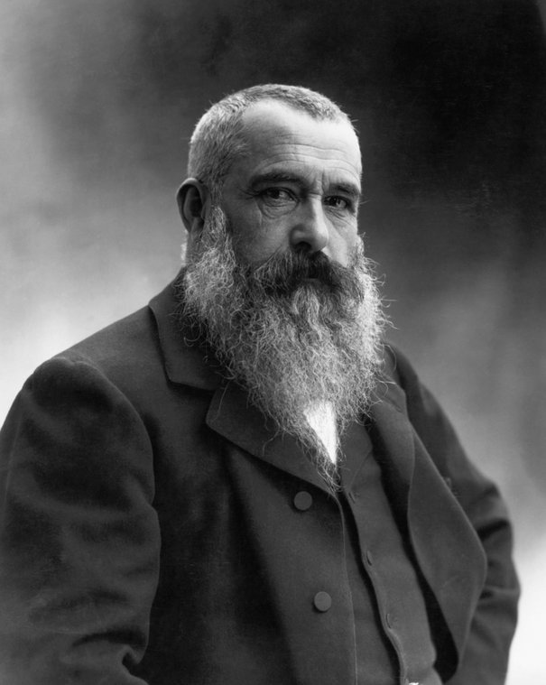
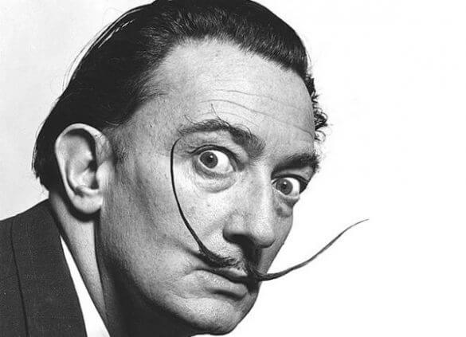
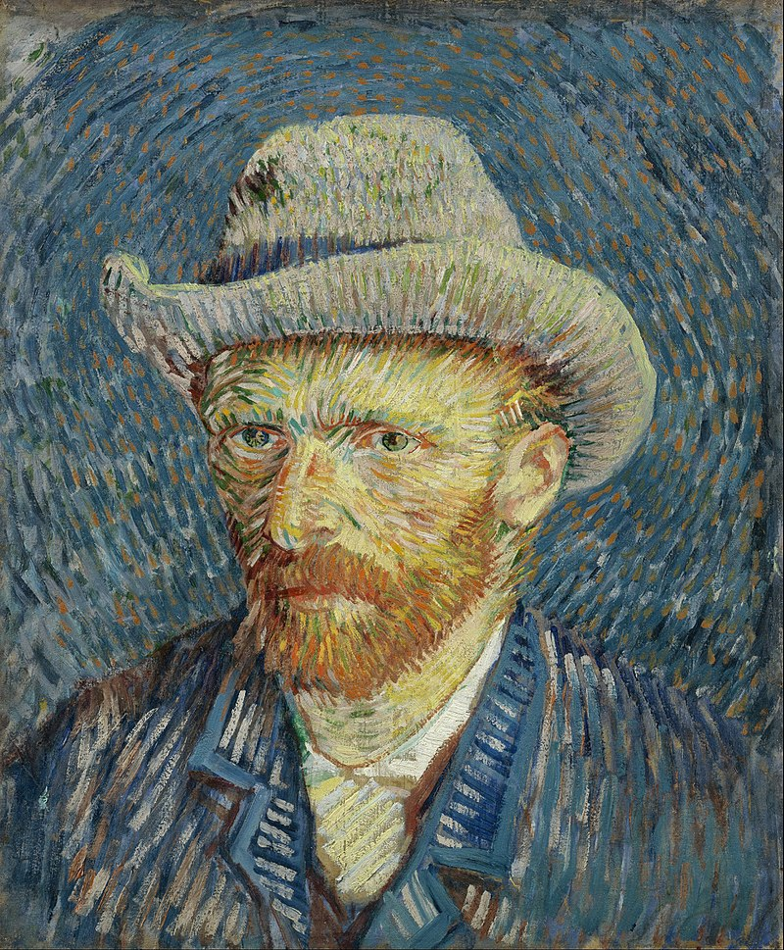
Different painters used to follow different styles in their paintings. Some painters used to have less colour variations, whereas some of them loved to use various colours within their paintings.
Here in this project, our motive is to visualize different colour palettes and colour variations in various paintings of some world famous painters.
For this study we have considered four painters namely Pablo Picasso, Claude Monet, Salvador Dali and Vincent Vann Gogh.

Slide 4
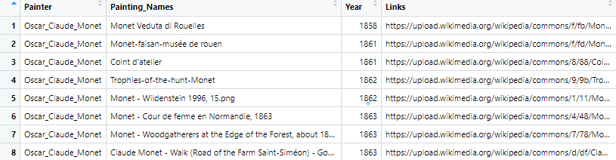
Description of the Data:
Kind of data we collected : To analyse the colour variations in paintings of different painters, paintings from different years were collected as potential dataset. Corresponding to each painter, that is, Pablo Picasso, Claude Monet, Vincent Vann Gogh & Salvador Dali, mainly name of the paintings, years they were made in and their corresponding links were scrapped from wikiart.com and Wikimedia.org.

Slide 5
Description of the Data:
Method of collection : Data extraction was done from different websites via web scraping in R software through library “rvest”.
Sources of Data :
https://commons.wikimedia.org/wiki/Paintings_by_Claude_Monet
https://www.wikiart.org/en/pablo-picasso/all-works/text-list
https://www.wikiart.org/en/vincent-van-gogh/all-works/text-list
https://www.wikiart.org/en/salvador-dali/all-works/text-list

Slide 6
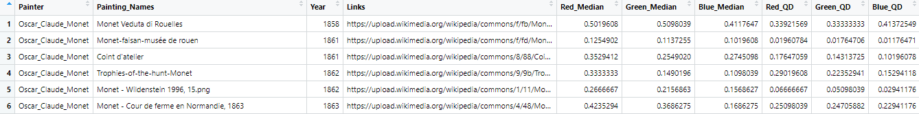
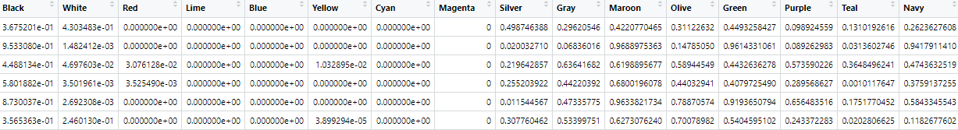
Description of the Data:
We have extracted 714 data points for each of the painters.
Using library “imager” in R software, have computed the medians, quartile deviations corresponding to three colour channels that is red, green and blue for each painting.
For each painting, the proportions of 16 basic colours have been computed.
Combining all these information, a data frame with 2856 rows and 26 columns have been constructed, based on which all the visualizations of data have been made.
Relevant Features of the Data:

Slide 7
Description of the Data:
Challenges faced in collecting the data :
It was difficult to find any website which contains a number of paintings that almost covers the painter’s career .
Images with size greater than 5MB were taking a lot of time in loading and sometimes even the R session got terminated during the calculation of different colour proportions.
Error occurred while loading images if the image format was not ‘jpeg’ or ‘png’ as we were working with ‘imager’ library.
Images that do not have four dimensions with first two corresponds to spatial dimensions, third corresponds to depth dimension and fourth denoting colour dimension(with three colour channels), were giving errors while loading the images.

Slide 8
Some Interesting Questions:
For a given painting can we produce a graph that tells the possible colours used in that painting, so that looking at the graph only we can predict the possible colours used in the corresponding painting?
Can the extent of colour variations for a given painting be measured?
In given painting what is the approximate colour proportion of a particular colour?
Whether on an average there were any differences in colour variations in a painting with respect to different painters?
Whether there are any painter who on an average used to use multiple colours in his paintings and whether there are any painter who on an average used to use flat colours throughout the painting?
How the use of different colours had changed over the respective careers of the painters?

Slide 9
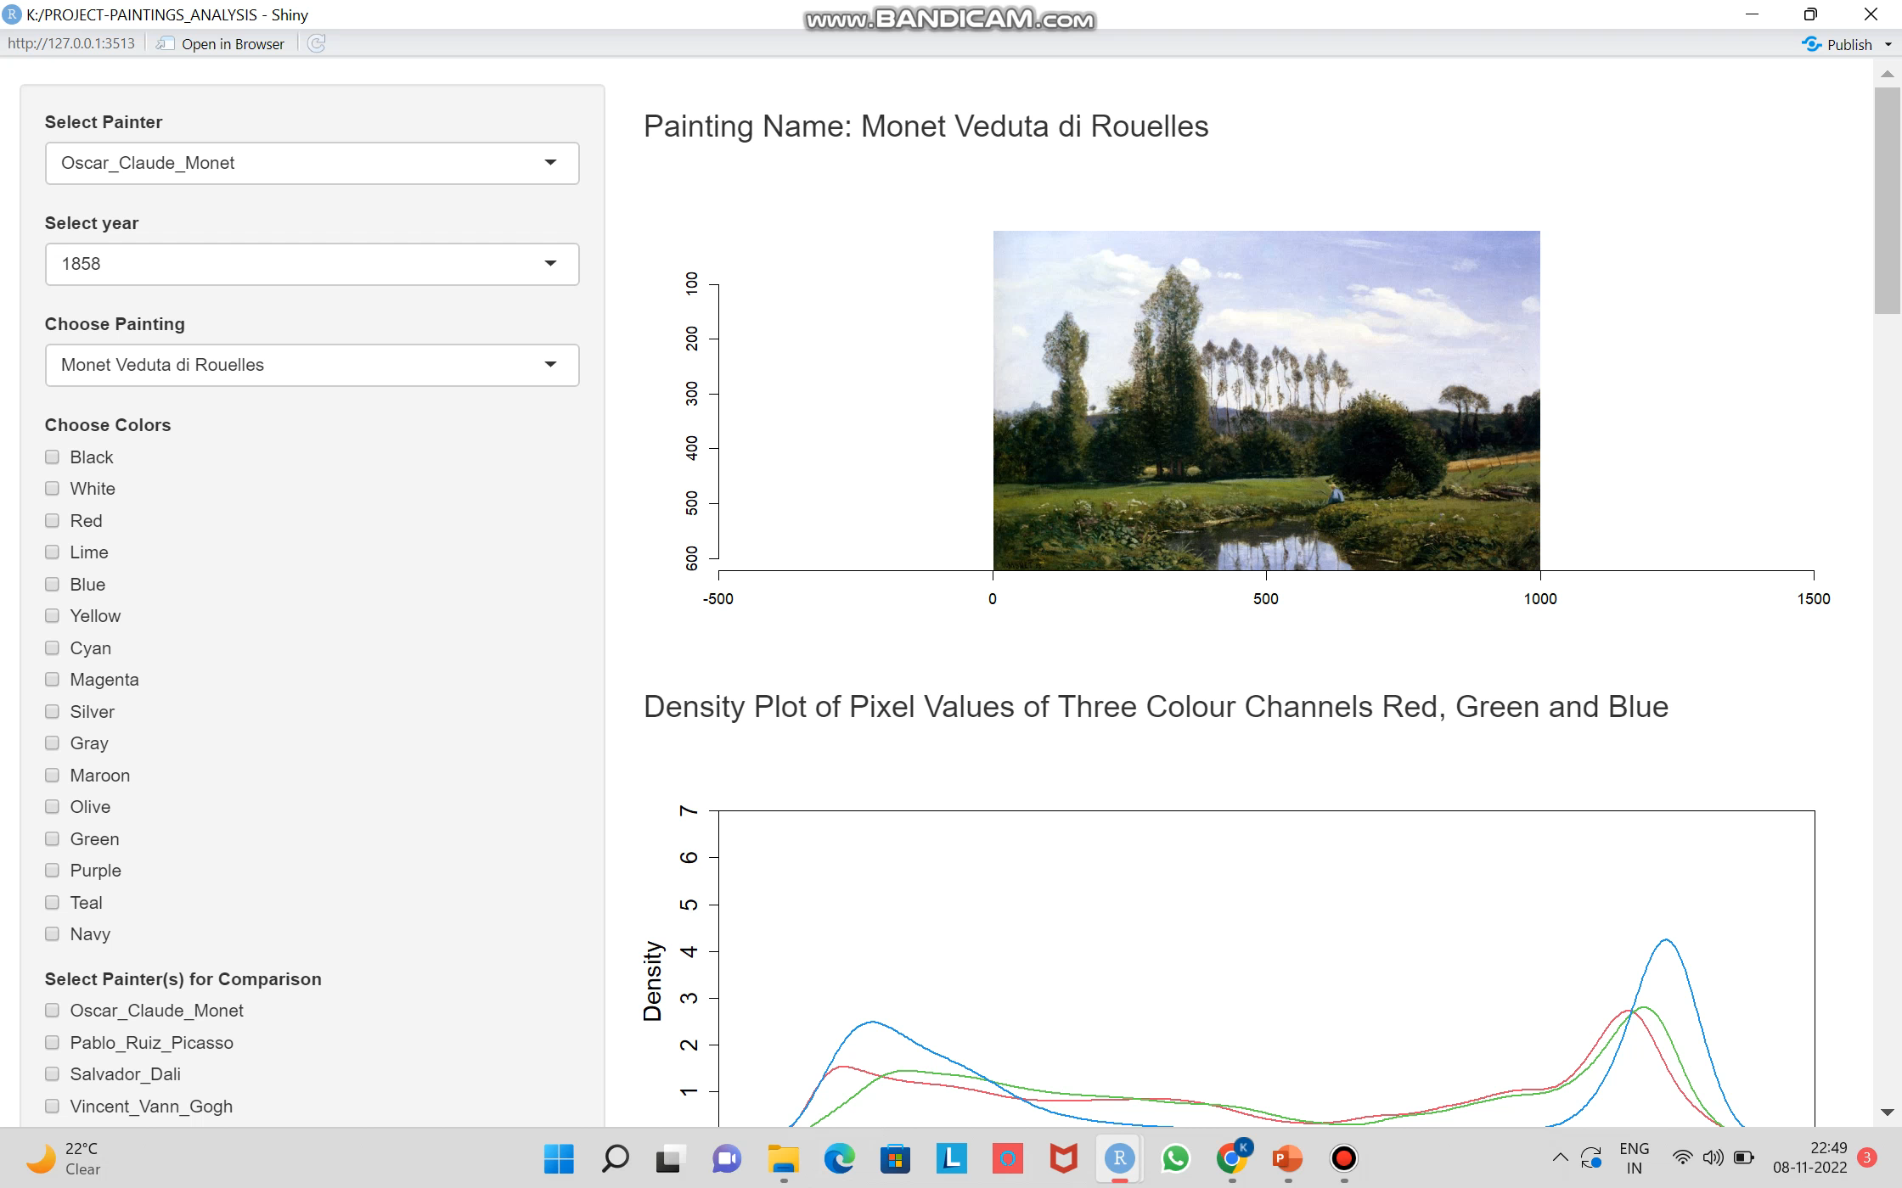

Slide 10
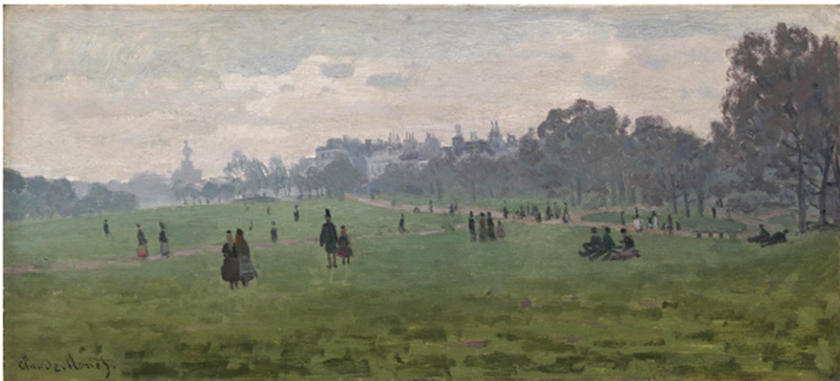
Artist : Claude Monet
Painting Name : Green Park , London
Year : 1870

Slide 11
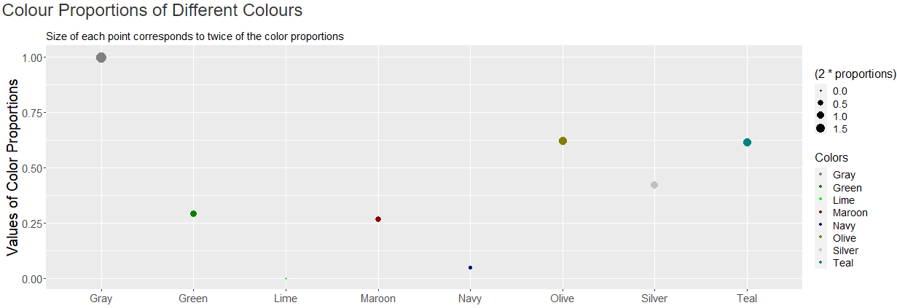
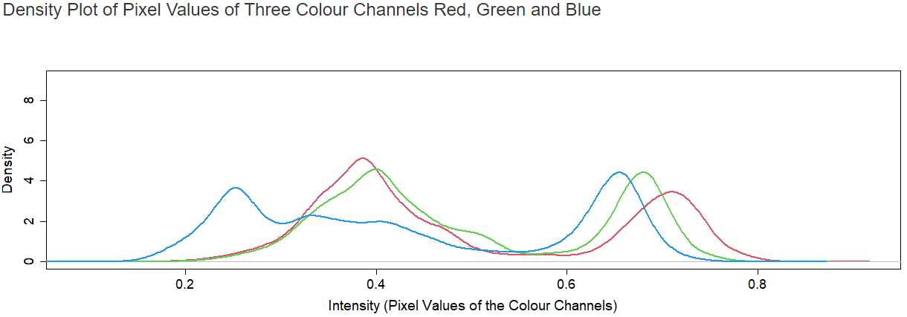
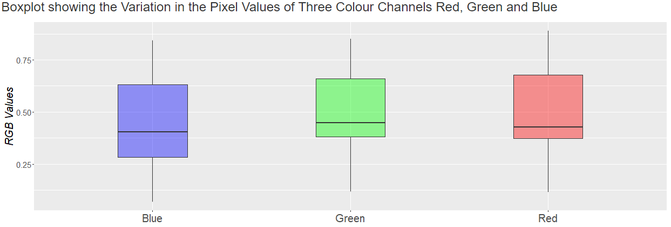

Slide 12
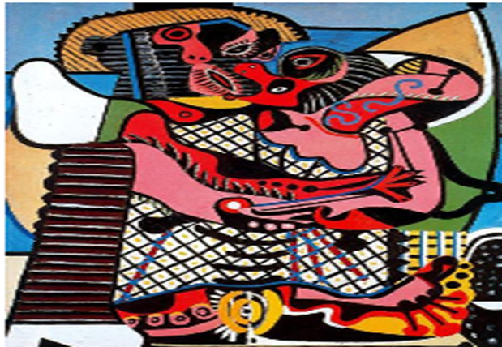
Artist : Pablo Picasso
Painting Name : The Kiss
Year : 1925

Slide 13
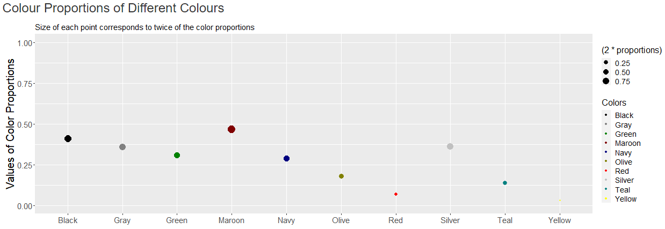
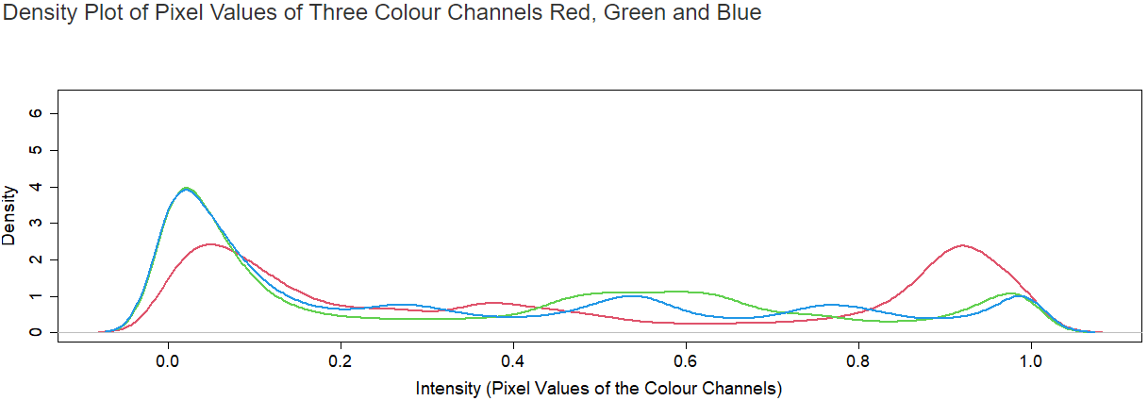
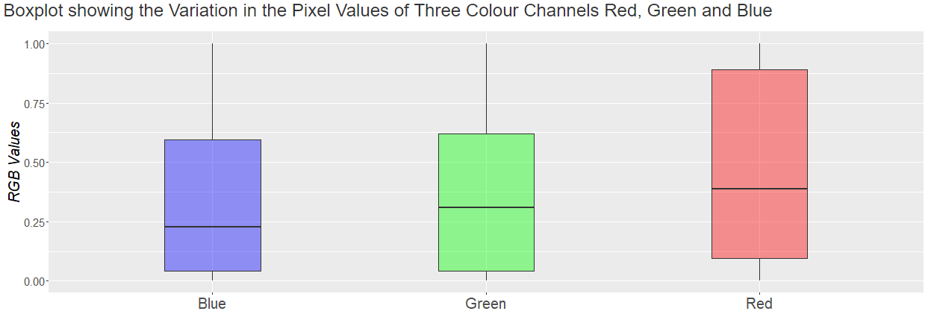

Slide 14
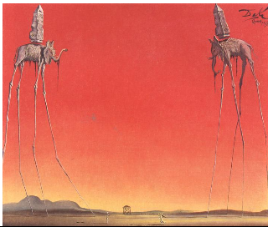
Artist : Salvador Dali
Painting Name : The Elephants
Year : 1948

Slide 15
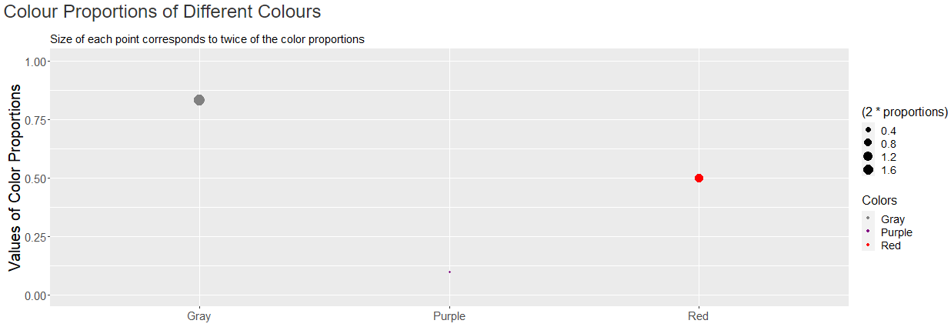
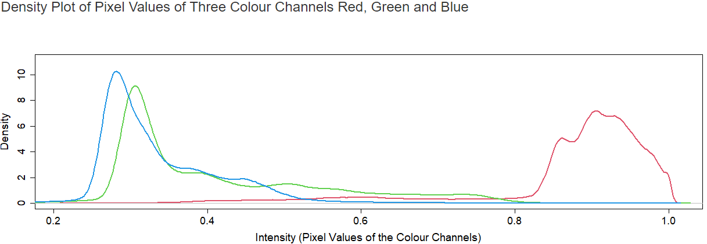
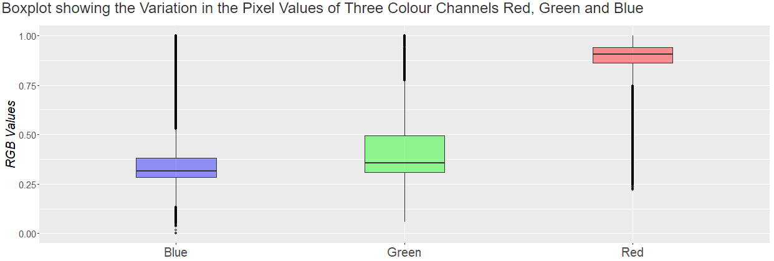

Slide 16
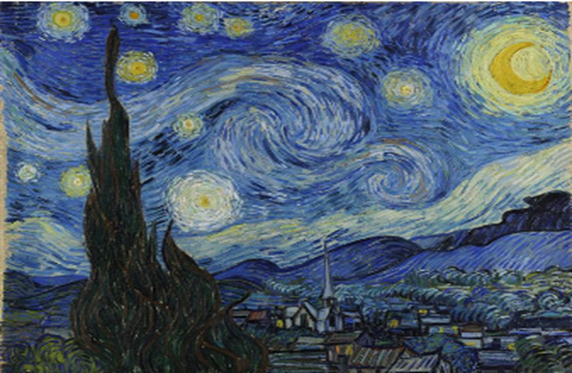
Artist : Van Gogh
Painting Name : The Starry Night
Year : 1889

Slide 17
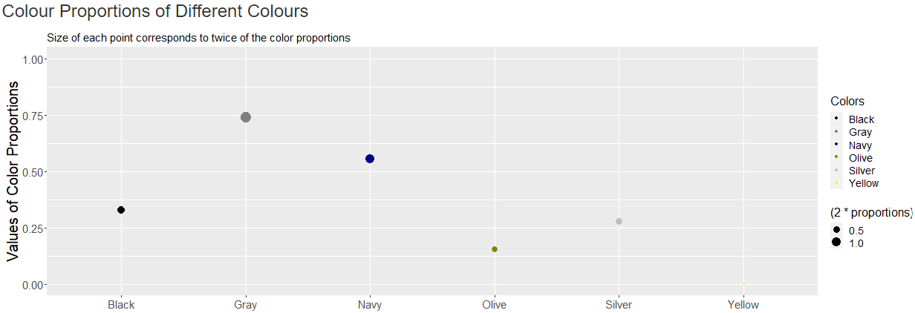
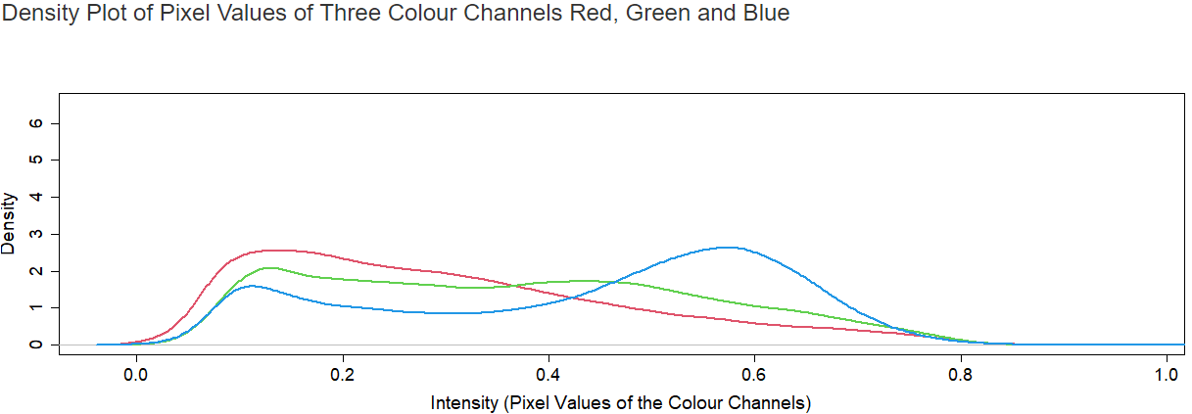
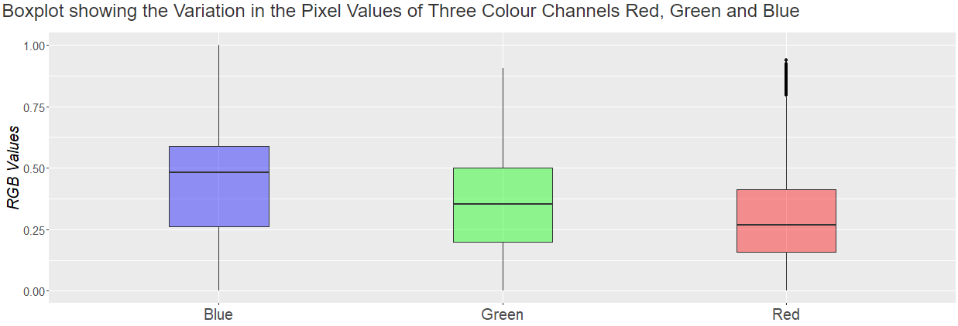

Slide 18
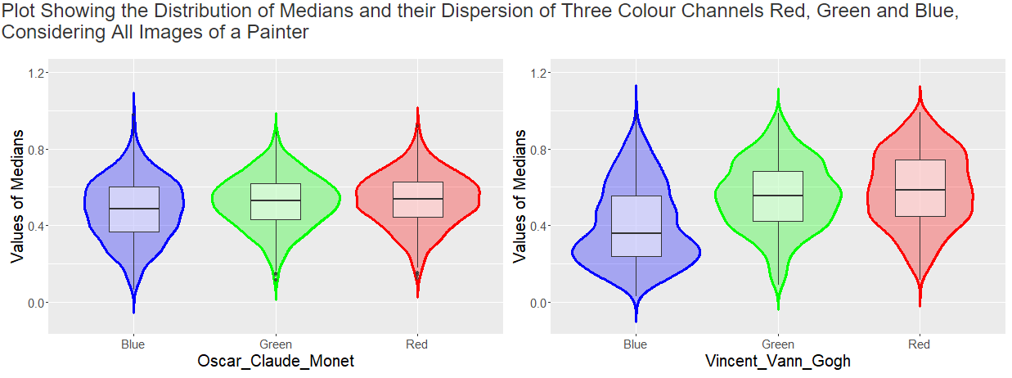
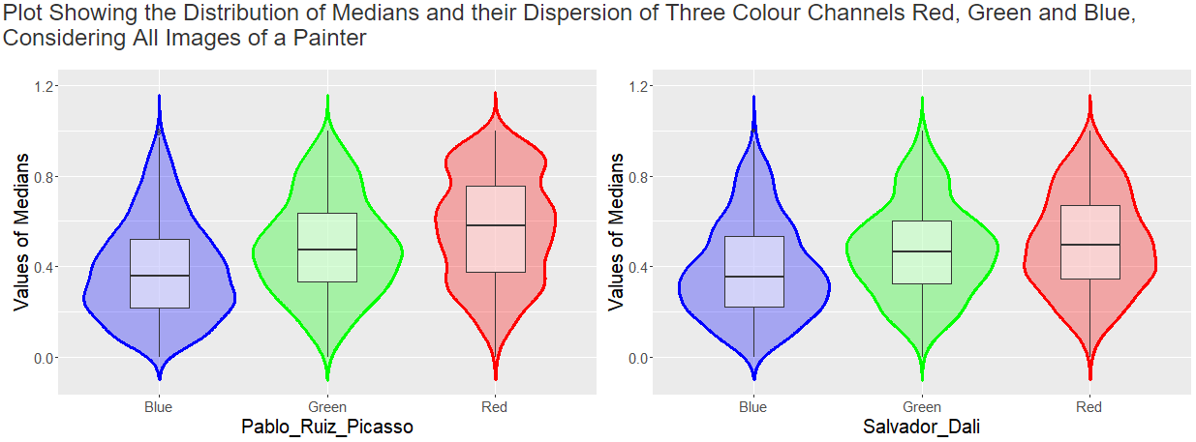
These plots show that, corresponding to a painter, on an average how the medians of three different colour channels vary.
Here we can see that the IQR of medians of different colour channels corresponding to Picasso and Salvador is more than that of Monet.

Slide 19
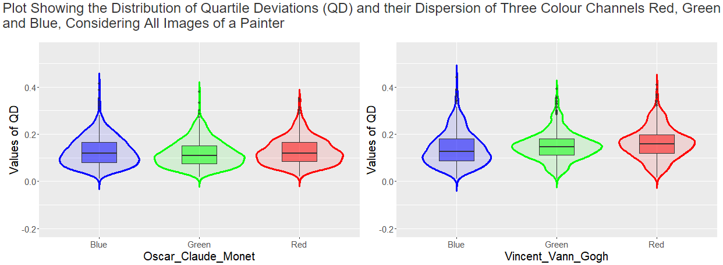
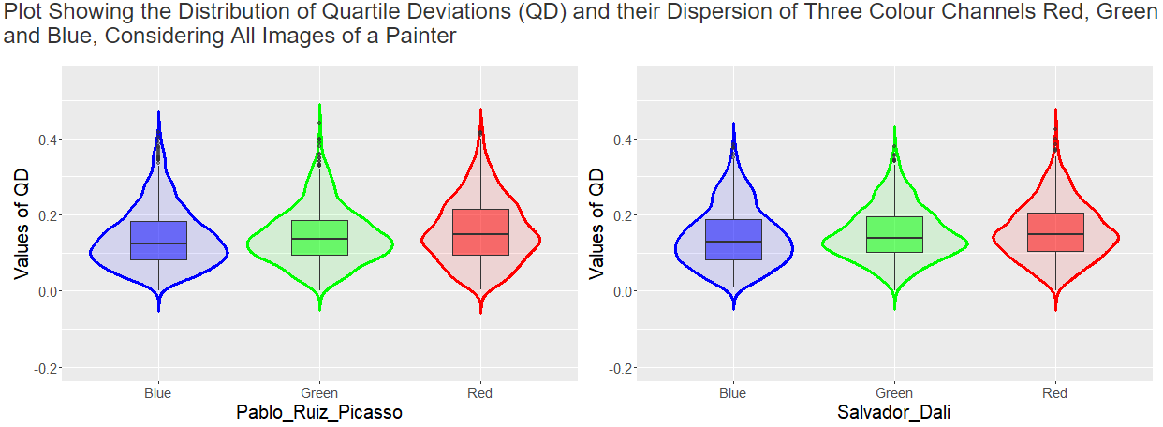
These plots show that, corresponding to a painter, on an average how the variation of three different colour channels vary.
Here we can see that the IQR of quartile deviations of different colour channels corresponding to Picasso and Salvador is more than that of Monet.

Slide 20
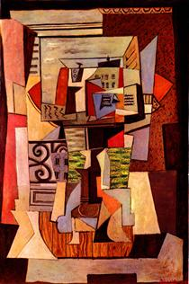
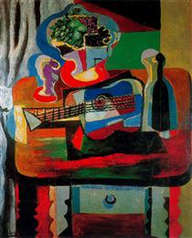
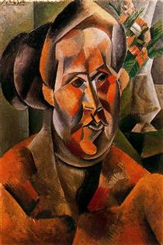
Within a painting, various shades of red were used by Picasso, which is supported by the violin and boxplot of median of red colour channel . Also, the in between variation of these various shades of red in different paintings also varies, which is depicted by the violin and boxplot of quartile deviations of red colour channel of all the paintings of Picasso. Now, the above paintings of Picasso also justifies this interpretation.

Slide 21
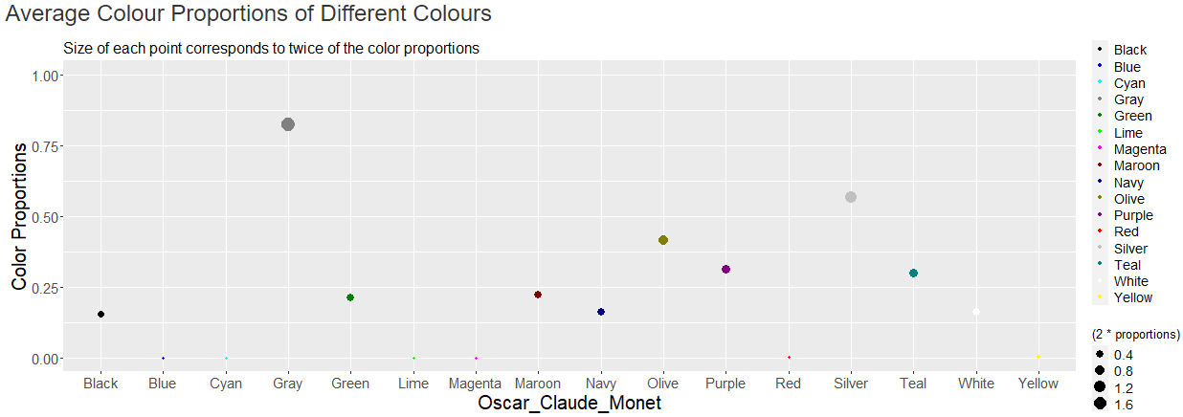
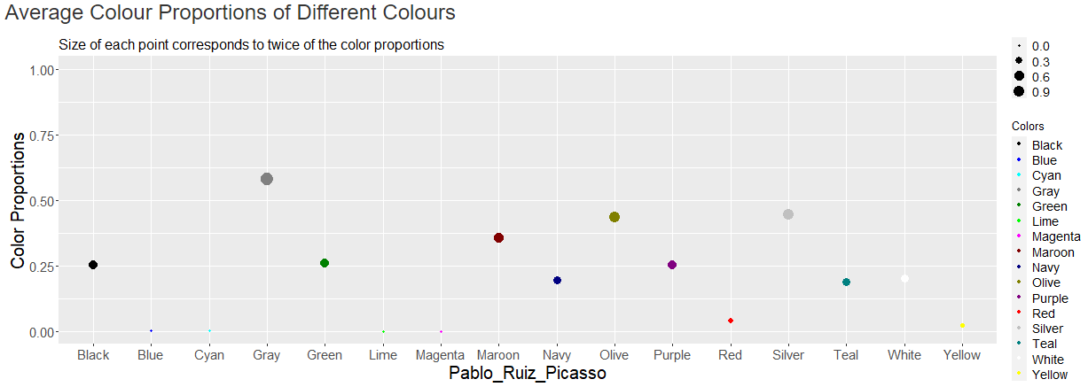
Proportions of Gray, blue and different shades of green was dominant in Monet’s paintings.

Slide 22
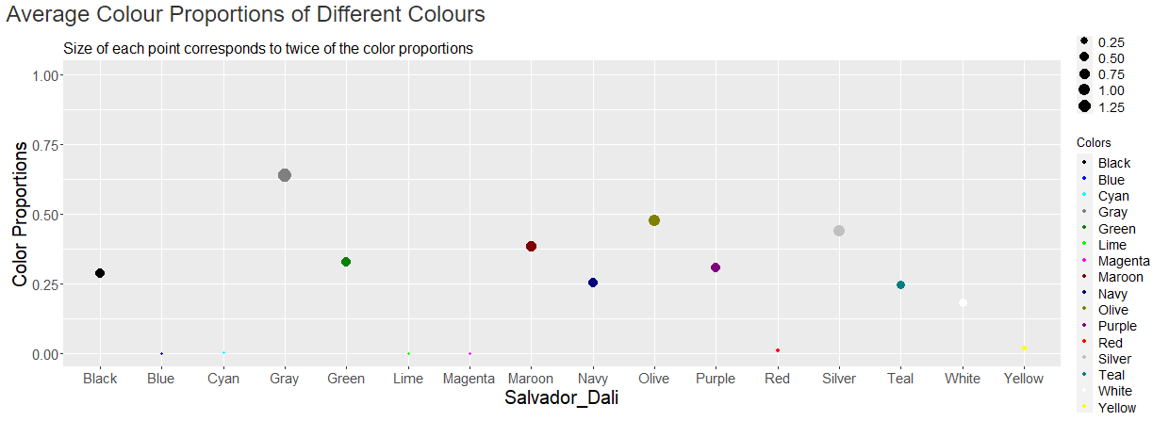
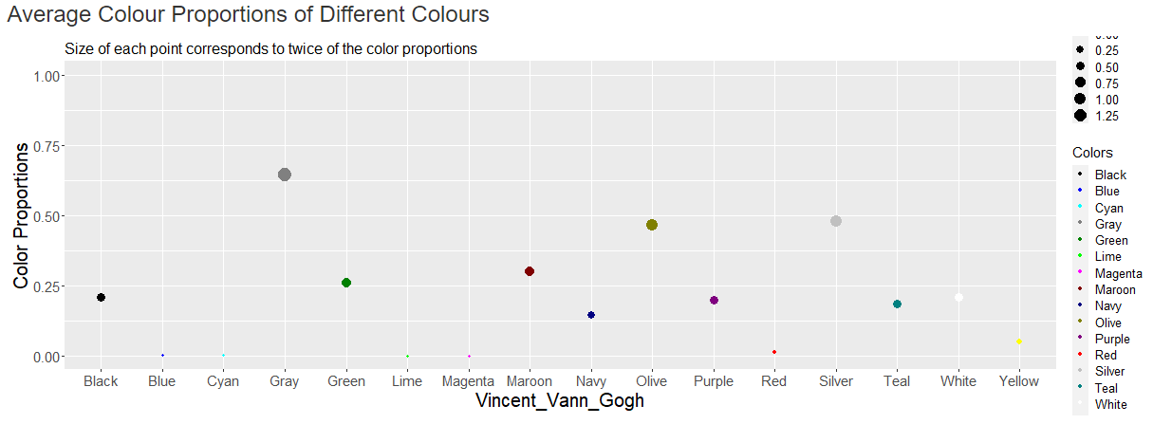

Slide 23
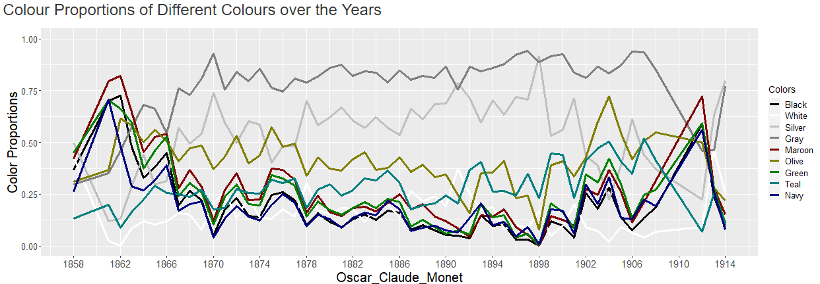
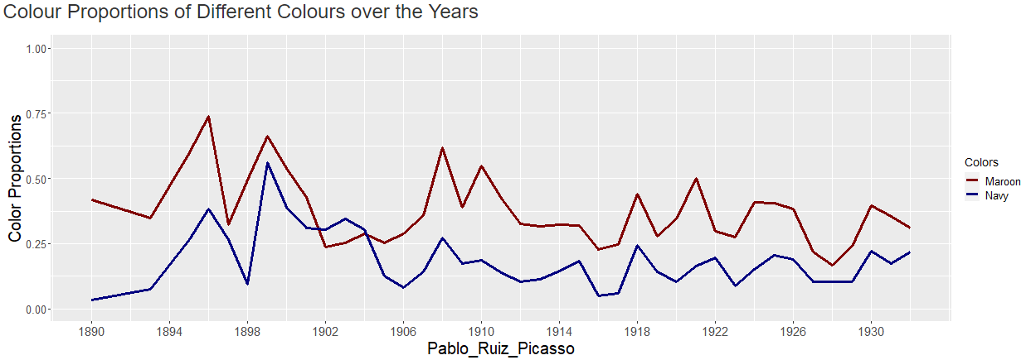
This graph supports the “ Blue Period (1900 – 1904) ” of Picasso.

Slide 24
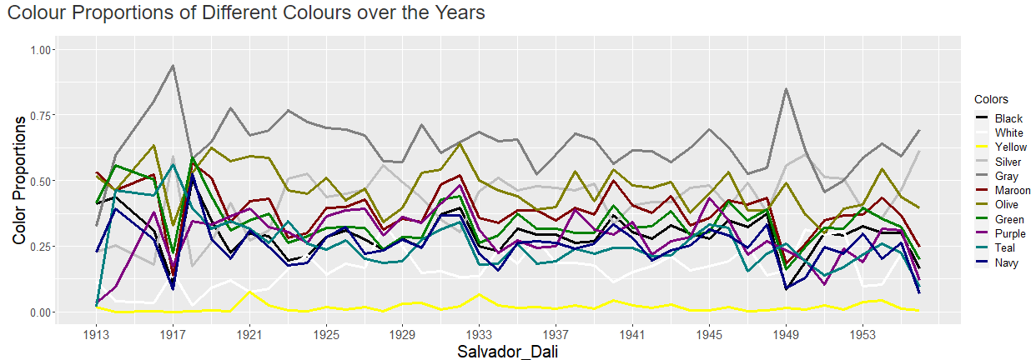
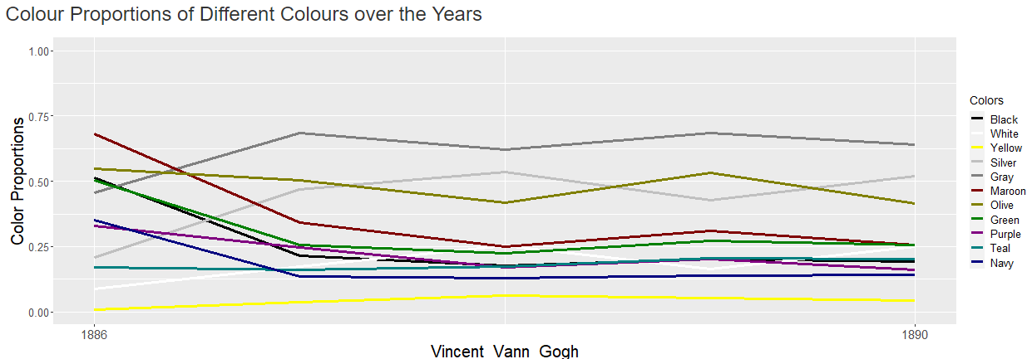

Slide 25
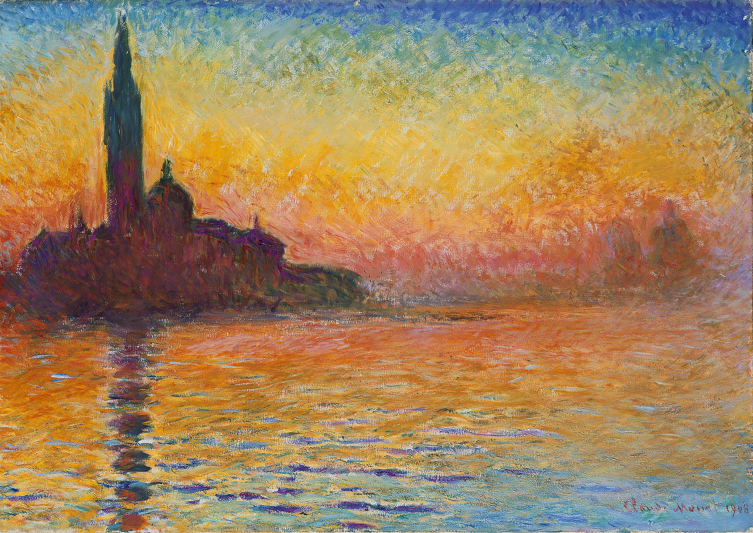
PANTONE® COLOR OF THE YEAR 2022
PAINTING ANALYSIS
~ THANK YOU ☺

